Slide 1
A Student Guide to Object-Oriented Development
Chapter 5 The Class Diagram

Slide 2
The Class Diagram
The class diagram appears through successive iterations at every stage in the development process.
It is used first to model things in the application domain as part of requirements capture.
It is used to design a solution.
Finally it is used to design the program code.

Slide 3
Stages in building a class diagram
There are several approaches depending on
the size and type of system being developed
the experience and ability of the team
procedures of the organisation concerned.
Notes:
Example – Wheels system, we will want to store data about bikes. Bikes will be objects in the system model and eventually in the code

Slide 4
Stages in building a class diagram
Two approaches:
Use case realisation – identify classes needed to perform functionality identified in use cases. Proceed use case by use case.
A domain model – model classes for the whole problem domain
Notes:
The group of classes required by a use case is called a collaboration.
Example – Wheels system, we will want to store data about bikes. Bikes will be objects in the system model and eventually in the code

Slide 5
Stages in building a class diagram
identify the objects and derive classes from them;
identify attributes of classes;
identify relationships between the classes;
write a data dictionary to support the class diagram;
identify class responsibilities using CRC cards;
separate responsibilities into operations and attributes;
iterate and refine the model.

Slide 6
Identify the objects and derive classes
various techniques can be used for object identification
none can be guaranteed to produce a definitive list of objects and classes
they are just guidelines that might help
search for nouns in the documentation a good starting point

Slide 7
Object identification using nouns
Find a complete description of system requirements
Underline all the nouns and noun phrases (person, place or thing)
This gives a list of candidate objects
Reject objects that will not make suitable classes

Slide 8
Description of problem:
BUILDING A CLASS DIAGRAM > IDENTIFY OBJECTS USING NOUNS
R1 keep a complete list of all bikes and their details including bike number, type, size, make, model, daily charge rate, deposit; (this is already on the Wheels system);
R2 keep a record of all customers and their past hire transactions;
R3 work out automatically how much it will cost to hire a given bike for a given number of days;
R4 record the details of a hire transaction including the start date, estimated duration, customer and bike, in such a way that it is easy to find the relevant transaction details when a bike is returned;
R5 keep track of how many bikes a customer is hiring so that the customer gets one unified receipt not a separate one for each bike;
R6 cope with a customer who hires more than one bike, each for different amounts of time;
R7 work out automatically, on the return of a bike, how long it was hired for, how many days were originally paid for, how much extra is due;
R8 record the total amount due and how much has been paid;
R9 print a receipt for each customer;
R10 keep track of the state of each bike, e.g. whether it is in stock, hired out or being repaired;
R11 provide the means to record extra details about specialist bikes.

Slide 9
Underline the nouns and noun phrases
BUILDING A CLASS DIAGRAM > IDENTIFY OBJECTS USING NOUNS
    R1 keep a complete list of all bikes and their details including bike number, type, size, make, model, daily charge rate, deposit; (this is already on the Wheels system);
    R2 keep a record of all customers and their past hire transactions;
    R3 work out automatically how much it will cost to hire a given bike for a given number of days;
    R4 record the details of a hire transaction including the start date, estimated duration, customer and bike, in such a way that it is easy to find the relevant transaction details when a bike is returned;
    R5 keep track of how many bikes a customer is hiring so that the customer gets one unified receipt not a separate one for each bike;
    R6 cope with a customer who hires more than one bike, each for different amounts of time;
    R7 work out automatically, on the return of a bike, how long it was hired for, how many days were originally paid for, how much extra is due;
    R8 record the total amount due and how much has been paid;
    R9 print a receipt for each customer;
    R10 keep track of the state of each bike, e.g. whether it is in stock, hired out or being repaired;
    R11 provide the means to record extra details about specialist bikes

Slide 10
List of nouns:
list of bikes
details of bikes: bike number, type, size, make, model, daily charge rate, deposit
Wheels system
record of customers
past hire transactions
bike
number of days
details of a hire transaction: start date, estimated duration
customer
receipt
different amounts of time
return of a bike
total amount due
state of each bike
extra details about specialist bikes

Slide 11
Remove attribute nouns:
BUILDING A CLASS DIAGRAM > IDENTIFY OBJECTS USING NOUNS
list of bikes
details of bikes: bike number, type, size, make, model, daily charge rate, deposit
Wheels system
record of customers
past hire transactions
bike
number of days
details of a hire transaction: start date, estimated duration
customer
receipt
different amounts of time
return of a bike
total amount due
state of each bike
extra details about specialist bikes
… information about a class, not a class itself
Notes:
Specialist Bike is probably going to be a class

Slide 12
Remove redundancy/duplicates
list of bikes
Wheels system
record of customers
past hire transactions
bike
hire transaction
customer
receipt
return of a bike
specialist bike
list of bikes
Wheels system
record of customers
bike
hire transaction
customer
receipt
return of a bike
specialist bike
… different names for the same thing
Notes:
Different amounts of time, number of days, estimated duration are probably the same thing, but we already removed them because they sounded like attributes.

Slide 13
Remove vague nouns:
BUILDING A CLASS DIAGRAM > IDENTIFY OBJECTS USING NOUNS
list of bikes
Wheels system
record of customers
bike
hire transaction
customer
receipt
return of a bike
specialist bike
list of bikes
Wheels system
record of customers
bike
hire transaction
customer
receipt
specialist bike
… words without precise meaning
Notes:
If we don’t know exactly what is meant by a term it it cannot be basis of useful class.

Slide 14
Remove nouns too tied up with physical inputs and outputs:
BUILDING A CLASS DIAGRAM > IDENTIFY OBJECTS UISNG NOUNS
list of bikes
Wheels system
record of customers
bike
hire transaction
customer
receipt
specialist bike
… data inputs or system products
Notes:
Receipt is an output from the system. List of bikes and record of customers should also be considered. Bike and Customer are good candidate nouns, but lists are too physical at this stage.

Slide 15
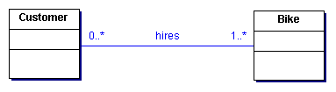
Remove association nouns:
Is hires an association or a class?
If there is data associated, probably a class
Hire: start date, number of days, so
Keep Hire as a class

Slide 16
Remove nouns that represent the whole system:
BUILDING A CLASS DIAGRAM > IDENTIFY OBJECTS USING NOUNS
Wheels system
bike
hire
customer
specialist bike
… we want to divide the system into separate
objects
Notes:
things which EXIST
not part of the intended system
outside the BOUNDARY
Car Park system not require details of these things

Slide 17
Remove nouns outside scope of system:
BUILDING A CLASS DIAGRAM > IDENTIFY OBJECTS USING NOUNS
From the Problem Definition (Chapter 2) we know
that the system will not cover:
- payroll
- personnel
- general accounting
… not part of the intended system
Notes:
things which EXIST
not part of the intended system
outside the BOUNDARY
Car Park system not require details of these things

Slide 18
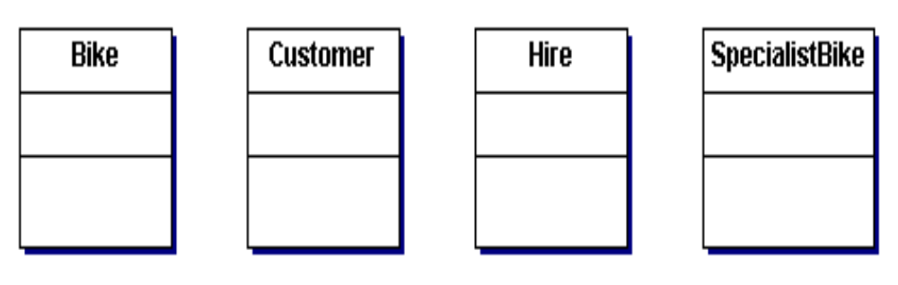
Identified objects, derive classes
BUILDING A CLASS DIAGRAM > DERIVE CLASSES USING NOUNS
bike
customer
hire
specialist bike
… these nouns are left as potential classes
Notes:
SIGN renamed to be more specific

Slide 19
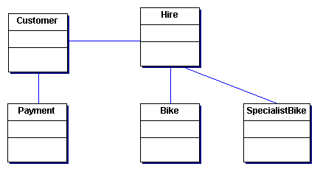
Add missing classes
Add Payment class
Not all classes appear as nouns in the problem description
Apply common sense

Slide 20
Identify attributes of classes
BUILDING A CLASS DIAGRAM
Many nouns will appear in the text being analysed e.g. bike number, available, type etc are attributes of bike.
Avoid
Attributes not relevant to current system – e.g. Customer passport number
Derivable attributes – e.g. cost of hire (dialyHireRate*numberOfDays)
Implementation attributes - pointers
Notes:
‘available’ appeared as ‘state of bike’ in the problem description - renamed for clarity

Slide 21
Identify relationships between classes
BUILDING A CLASS DIAGRAM
During analysis we have not yet got an exact notion of how objects will need to communicate with each other
The relationships that we include at this stage model real-life relationships that we think might be useful
We will not have an exact idea of the navigable paths we need to build in until after looking at the interaction diagram.

Slide 22
Identify relationships between classes
During analysis we have not yet got an exact notion of how objects will need to communicate with each other;
the relationships that we include at this stage model real-life relationships that we think might be useful.
We will not have an exact idea of the navigable paths we need to build in until after looking at the interaction diagram.

Slide 23
Associations and Multiplicity
BUILDING A CLASS DIAGRAM > IDENTIFY RELATIONSHIPS
The Hire class holds data about the hiring of a bike. It needs to communicate with the Bike class to work out the cost of a hire (numberDays*dailyHireRate)
To perform this calculation there must be a relationship between Hire and Bike

Slide 24
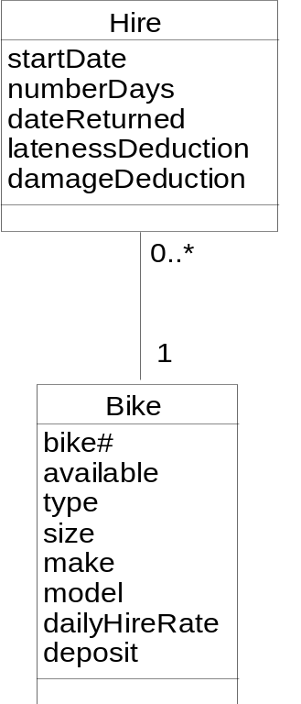
Associations and Multiplicity
BUILDING A CLASS DIAGRAM > IDENTIFY RELATIONSHIPS
Relationship between Hire and Bike showing that a :Hire is for only one :Bike but a :Bike can be hired 0, 1 or many times

Slide 25
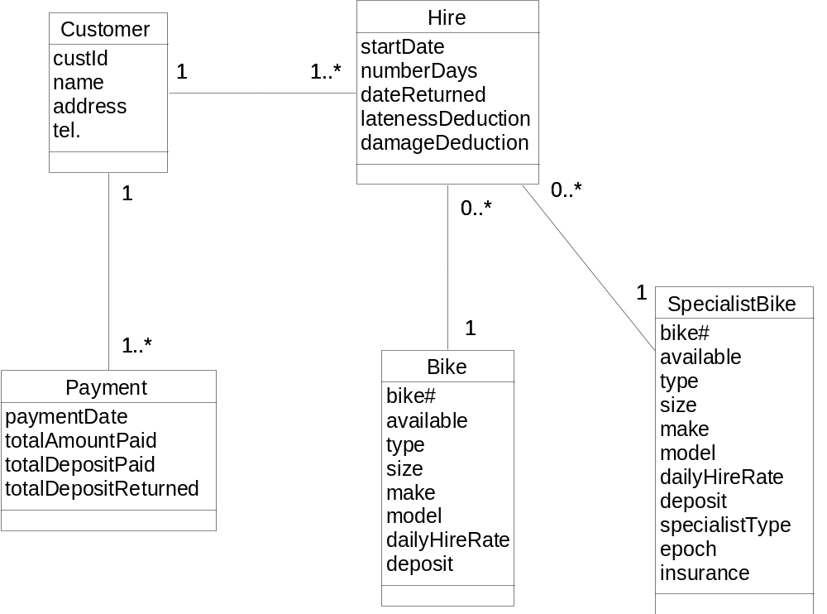
Wheels class diagram with initial associations

Slide 26
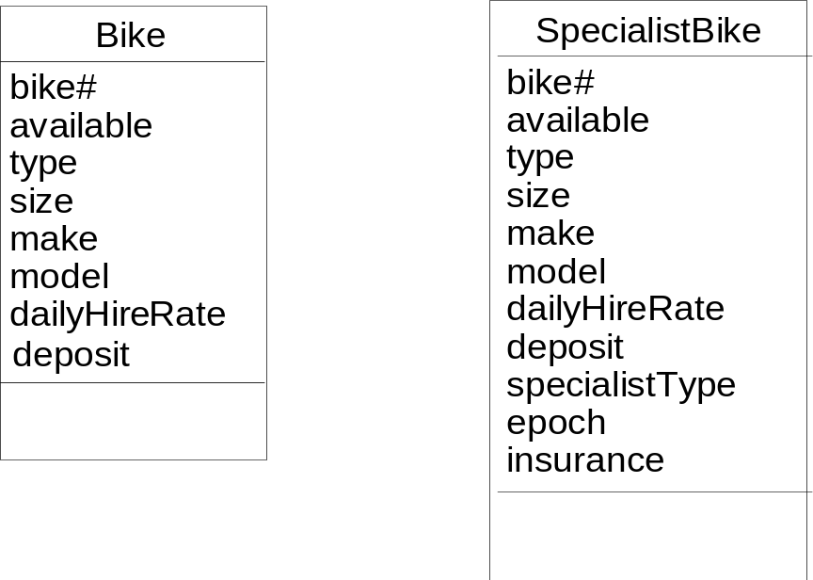
Generalization and inheritance
Many shared attributes
type same as specialistType ,

Slide 27
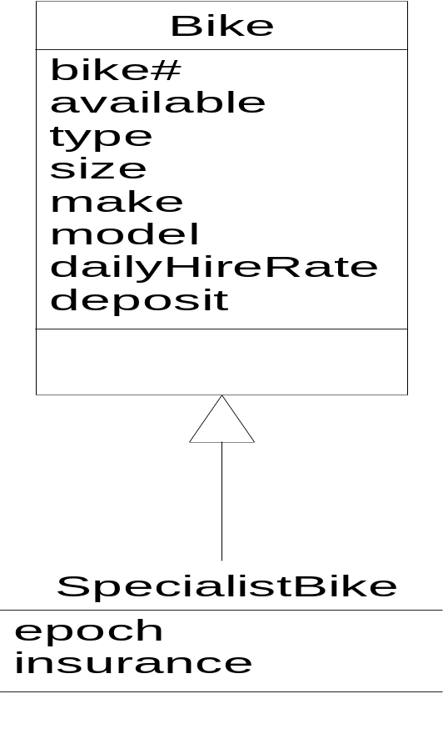
Inheritance
BUILDING A CLASS DIAGRAM > IDENTIFY RELATIONSHIPS
Shared attributes inherited by SpecialistBike
Distinguishing attributes (epoch and insurance) are unique to SpecialistBike

Slide 28
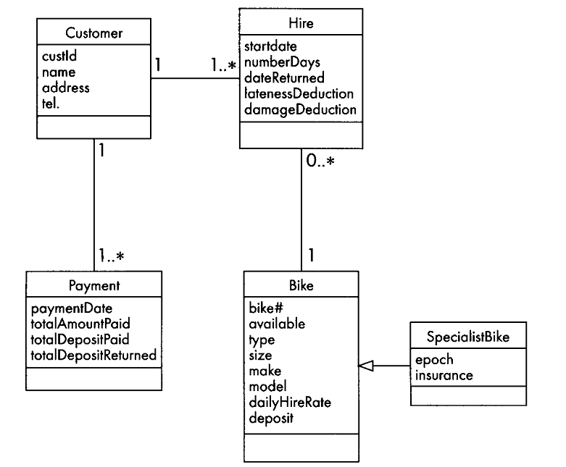

Slide 29
Data dictionary to support class diagram
The data dictionary notation that we use in this book is semi- formal, and suitable for documenting the data of a small information system.
We want to be able to define classes in terms of their attributes including:

Slide 30
Data dictionary to support class diagram
The order in which they are listed (e.g. name, address, phone number)
Whether an attribute is repeated (e.g. a customer may have more than one phone number)
Any restrictions on the number of repetitions
Whether an attribute is optional (e.g. a customer may or may not have an email address)
The set of possible values for an attribute (e.g. in some businesses a customer may be individual or wholesale)
Selection between alternative values for an attribute (e.g. a customer is either individual or wholesale).

Slide 31
Data dictionary to support class diagram
the data dictionary is constructed in parallel with the other models,
details are added to the dictionary definitions as more information becomes available,
the main UML models are cross-referenced via entries in the data dictionary as a means of ensuring consistency between them.
more detail will be needed as we move closer to implementation

Slide 32
Data dictionary notation
MEANING | SYMBOL | DESCRIPTION | EXAMPLE
consists of | = | introduces the definition of a data item | Customer =
and | + | joins components of the definition in sequence | Customer = name + address
one or more | { } | attribute may be repeated; any restrictions on the number of repetitions are written in subscript | Customer = name + address + {phone}₂
zero or one | ( ) | attribute is optional | Customer = name + address + {phone}₂ + (email)
alternatives | [ ] | selection is indicated by enclosing the alternative attributes in square brackets [ ] | Name = [initial | firstname] + surname
either.. or | | | alternatives for selection in [ ] are separated by a vertical bar
specific value | “ ” | indicates specific values | “individual”, “wholesale”
*…* | comment | comments are enclosed between asterisks | Customer = name + address + {phone}₂ + (email) + ["individual" | "wholesale"] *Wholesale customers are entitled to special discounts*

Slide 33
titleSection
Wheels Bikes Receipt for Hire Date______________ Customer name ______________________________________________ Address ______________________________________________ ______________________________________________
Bike No. | Bike description | Rate per day | No. of days | Hire cost | Deposit | Total cost
Amount due Paid with thanks.
customerDetails
hireDetails
total
receipt = titleSection + customerDetails + {hireDetails} *a customer may hire more than one bike at a time* + total
titleSection = "Mikes Bikes Receipt for Hire" + receiptDate
customerDetails = customerName + customerAddress
hireDetails = bikeNo. + bikeDescription + ratePerDay + noOfDays + hireCost + deposit + totalCost
total = amountDue + "Paid with thanks“
We can decompose to further levels as needed, for example we could add:
bikeDescription = make + model + type + size

Slide 34
What makes a good class?
Problem domain During analysis, classes should correspond to things in the real world of the problem domain
Functionality A class (at least during analysis) usually has both attributes and behaviour.
Cohesion One of the qualities of a good software construct, listed at the beginning of this chapter, is cohesion. A class is cohesive if it is concerned with only one thing, if all its attributes and operations relate to the same topic.

Slide 35
Summary
The class diagram defines the software architecture and the internal structure of the objects in an object-oriented system
the classes we model in the class diagram form the basis of the classes in the code
The stages in the construction of a class diagram are
  identifying objects and deriving classes
  identifying attributes
  identifying relationships
  writing a data dictionary
  identifying operations
  writing operation specifications.

